Slide 1
Data Innovation Challenge
Managing Healthcare Costs in Singapore
Presented by
Aung Myint Thein
7 May 2014

Slide 2
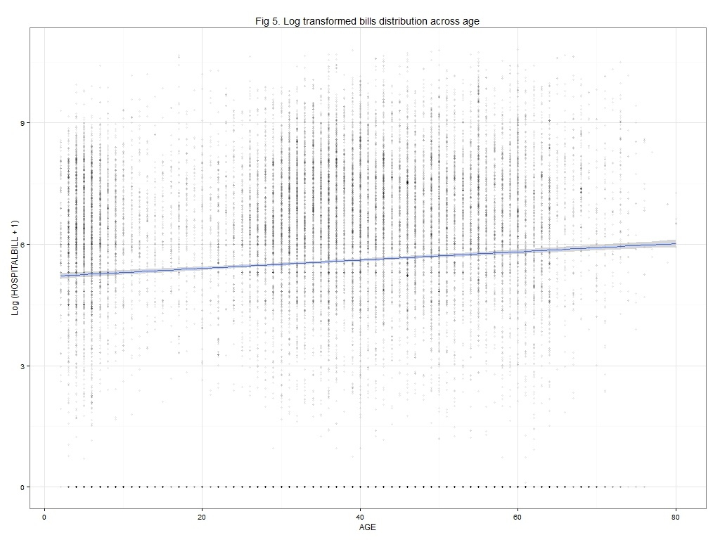

Slide 3
